Slide 1
Visualization of biological data
Piotr Gawron
(piotr.gawron@uni.lu)

Slide 2
Outline (day 1)
Introduction
Evaluation
Requirements
Basics of HTML + JavaScript

Slide 3
Outline (day 2)
What is BioJS?
How to use BioJS component
Introduction to node.js
Extension of the component
Development of your own component

Slide 4
Outline (day 3)
Maintenance and testing
Quality of the code (and tests)
Some Node.js/JavaScript issues
Reactome - A Database of human biological pathways

Slide 5
Outline (day 4)
Programatic access to Cytoscape
Psicquic – introduction
Getting data from psicquic

Slide 6
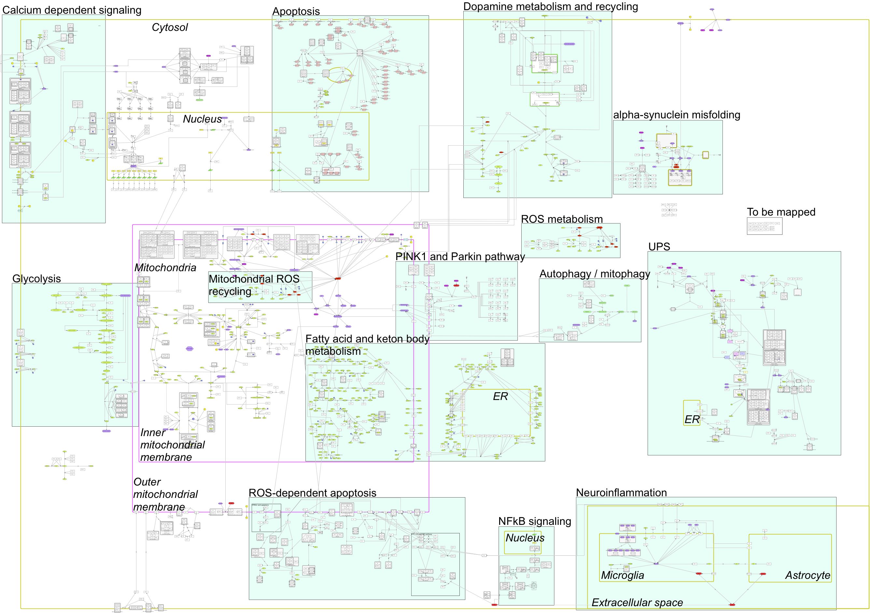

Introduction (few words about myself ;-) http://pdmap.uni.lu/
Notes:
For online presentation we should go this way:
Complexity
full map
compartments and pathways – semiautomatic hierarchical view
Submaps
Biological overview
Searche engine
Annotations
Pubmed
Others
Layouts
Build in layouts
Present custom upload
Drug interface
Try it with mix between drug, search and layouts
Comments
Export:
Celldesigner
Image
Elements/network

Slide 7
Evaluation
Report about the practical part (90%)
Participation and presence (10%)

Slide 8
Evaluation
Report about the practical part (90%)
Participation and presence (10%)
50% for presence
50% for practical exercises during course

Slide 9
Requirements (day 1-3)
Google chrome browser
Npm
Node.js
git
Any text editor (notepad, vim, etc)

Slide 10
Requirements (day 4)
Cytoscape
Postman (Chrome application)

Slide 11
HTML
HTML is a markup language for describing web documents (web pages).
HTML stands for Hyper Text Markup Language
A markup language is a set of markup tags
HTML documents are described by HTML tags
Each HTML tag characterizes different document content
<html>
<head>
<title>My first web page</title>
</head>
<body>
<h1 id='blabla'>Hello world</h1>
</body>
</html>

Slide 12
HTML Basics
HTML is designed for marking up text by adding tags such as <p> to create HTML elements. HTML tags begin with < and end with >. Tags often occur in pairs of opening and closing tags. Some tags such as <img> always occur alone. Those tags usually (but do not require to) have a trailing slash. Tags can have attributes. For example, <a> tag has href attribute for defining link target. Similarly, <img> tag has src attribute for defining image source.

Slide 13
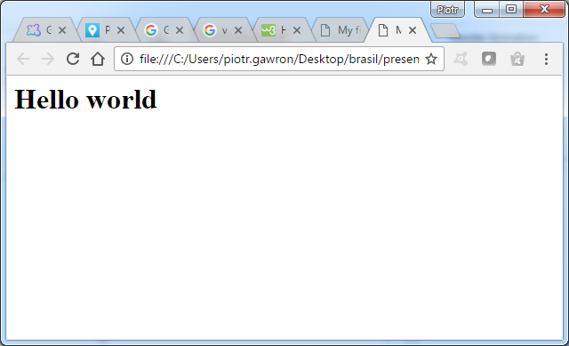
HTML's tree structure
<html>
<head>
<title>My first web page</title>
</head>
<body>
<h1 id='blabla'>Hello world</h1>
</body>
</html>

Slide 14
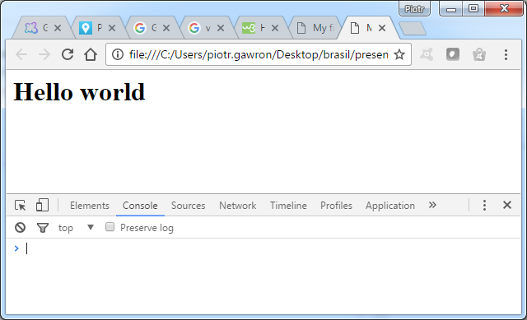
HTML's tree structure
Let’s open Tools for developers in chrome broswer

Slide 15
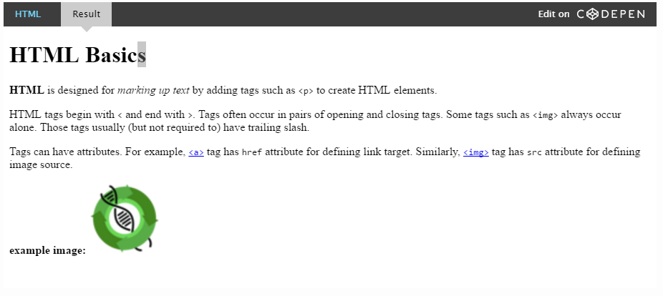
Use HTML to Structure Site Content html, body, h1, p, strong, em, a, img

Slide 16
HTML's tree structure
Objects in the DOM can be manipulated by JavaScript (add/remove/modify Element)
<html>
<head>
<title>My first web page</title>
</head>
<body>
<h1 id='blabla'>Hello world</h1>
</body>
</html>

Slide 17
What is JavaScript?
A programming language for the web, generally executed client-side (in your web browser).
JS code is written in 'scripts' which are run when the page renders.
There are two ways to include JS:
In the document
<script type="text/javascript">
alert("Hello world!");
</script>
In a separate file
<script src="viz.js"></script>

Slide 18
Objects in the DOM can be manipulated by JavaScript
//Objects in the DOM can be manipulated by JavaScript function
changeTitle(){
var title = document.getElementById(“blabla");
title.innerText = "See?? JS can manipulate dom objects";
}

Slide 19
Objects in the DOM can be manipulated by JavaScript
Sample.html
myCode.js
<html>
<head>
<title>My first web page</title>
<script language="javascript" type="text/javascript" src="myCode.js"></script>
</head>
<body>
<h1 id='blabla'>Hello world</h1>
<button onclick="myFunction()">Click me</button>
</body>
</html>
function myFunction(){
alert("I'm javascript function code in separate file");
}

Slide 20
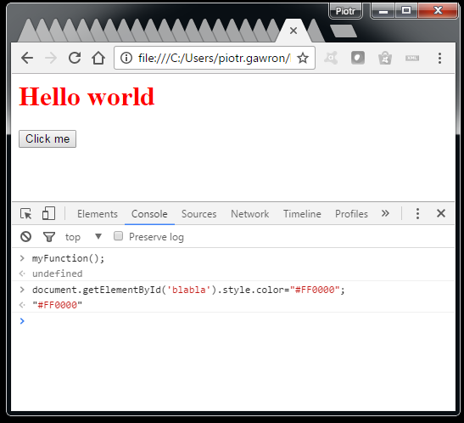
When you are using Chrome you can enter any javascript code in the runtime just by opening console window and typing the code:

Slide 21
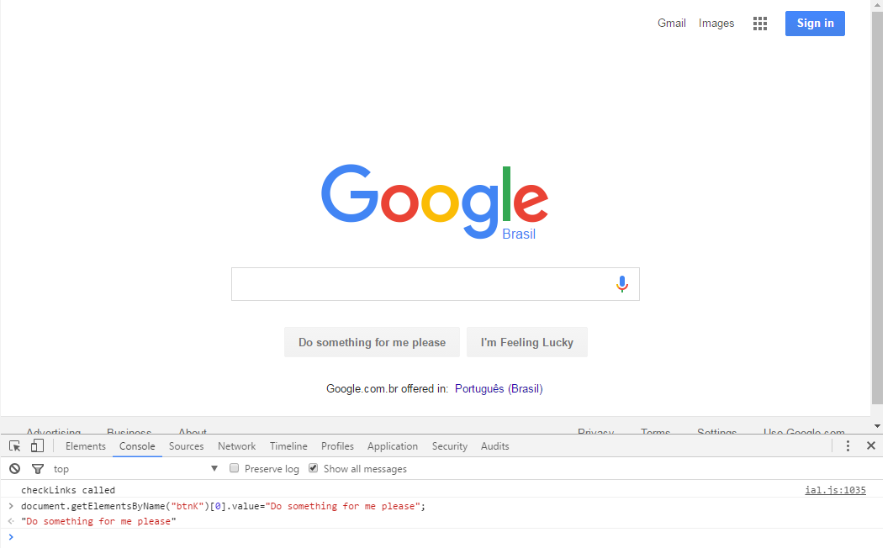

Slide 22
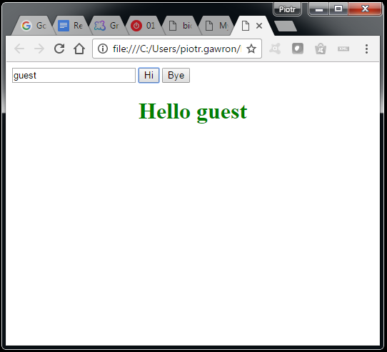
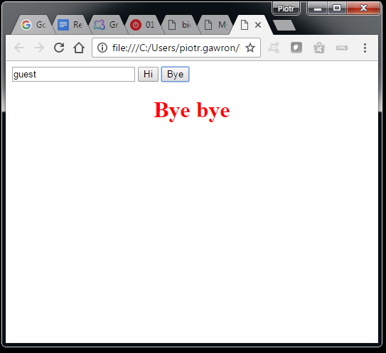
Exercise 1 (together)
Try to create html and javascript code, so there will be two buttons and input text. Clicking on the first button will result in the green message: “Hello <your name>”. Clicking on the second one will result in red message: “Bye, bye”.

Slide 23
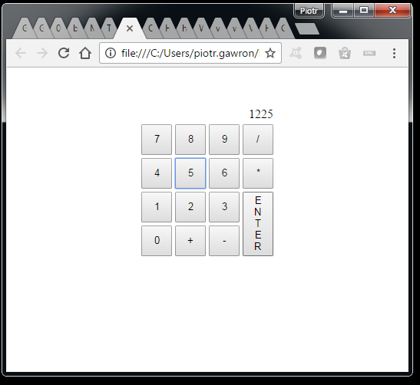
Exercise 2 (alone)
Create simple calculator like the one shown in the bottom.

Slide 24
Day 2 – BioJS at a glance
What is BioJS? A collection of JavaScript components to represent biological data (+ guidelines)
Who is involved? Open source project. Everybody welcome to contribute as: Users, Developers and Collaborators
Where?
Web: biojs.net
Discover at biojs.io
Tutorials at edu.biojs.net
Code at Github (github.com/biojs/biojs)
Components at npm

Slide 25
BioJS principles
A component should be easy to:
Discover
Use
Combine and integrate
Extend and Maintain

Slide 26
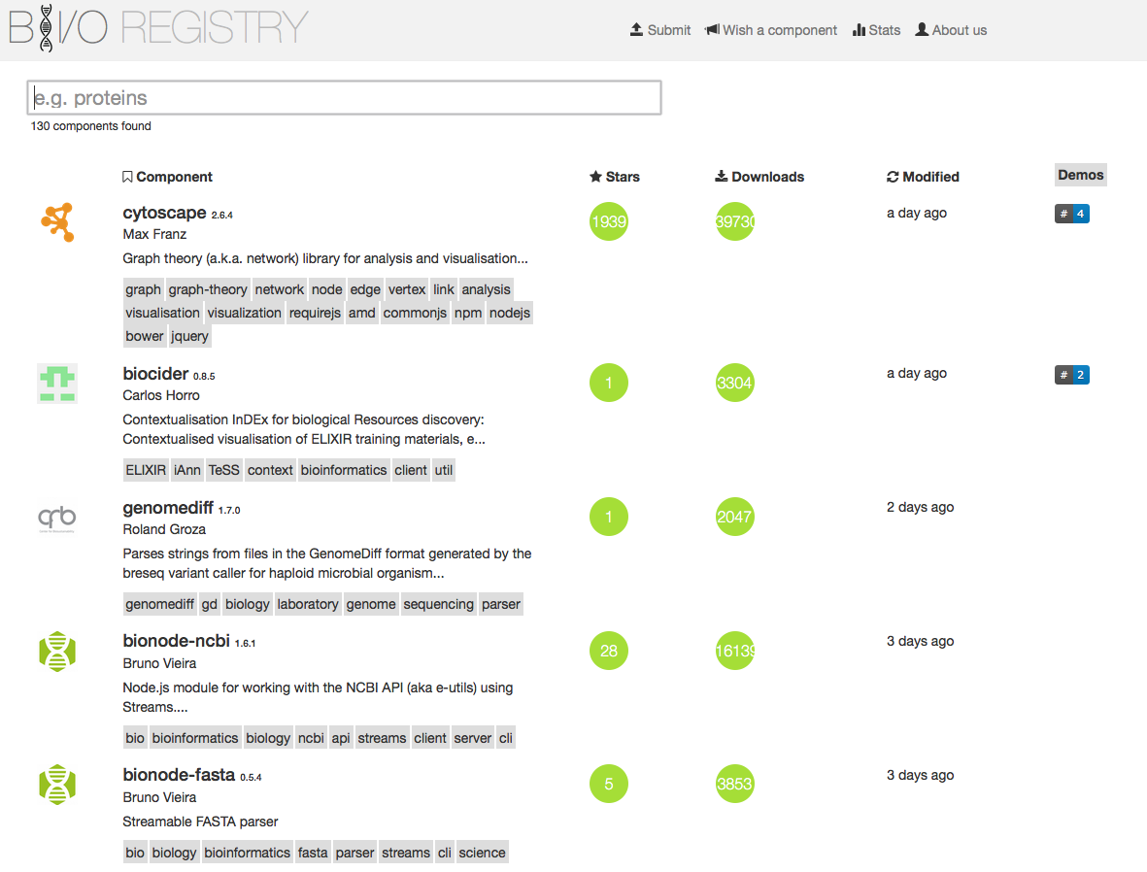
Discover - biojs.io

Slide 27
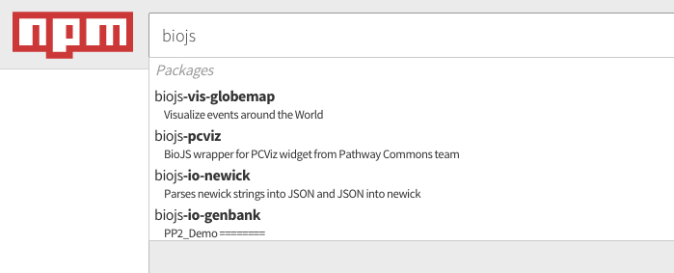
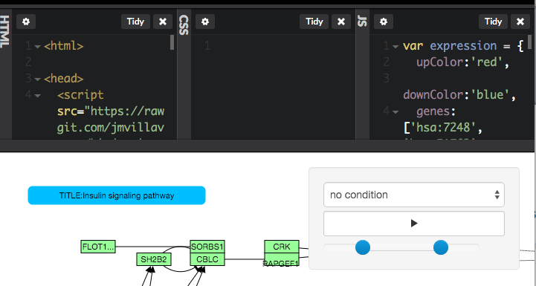
Use install, configure, go

Slide 28
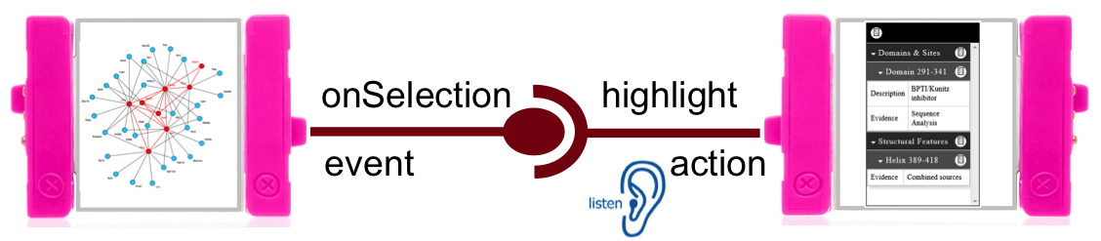
Combine and integrate

Slide 29
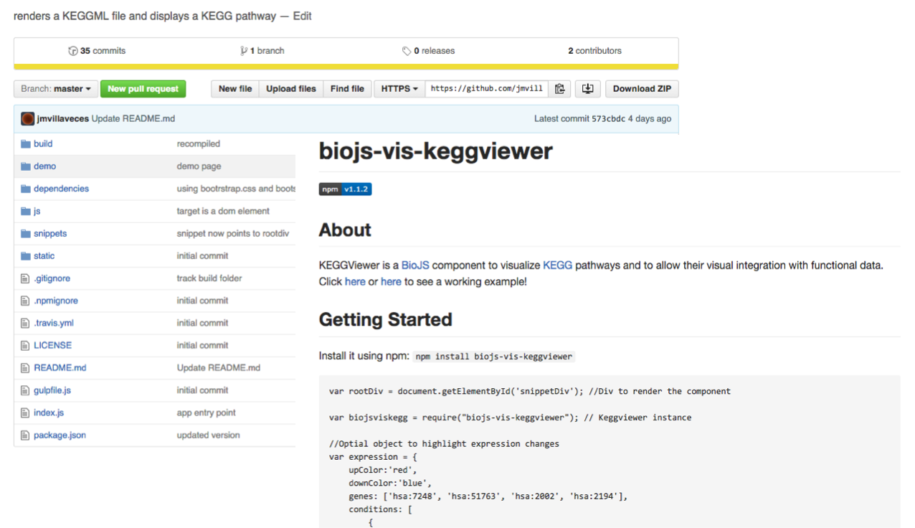
Extend

Slide 30
Benefits
Share development
Enhance the visibility of your widget
Make components not just for you but for the community
Isolate visualization from your web framework
Easy to add functionality by extending a component

Slide 31
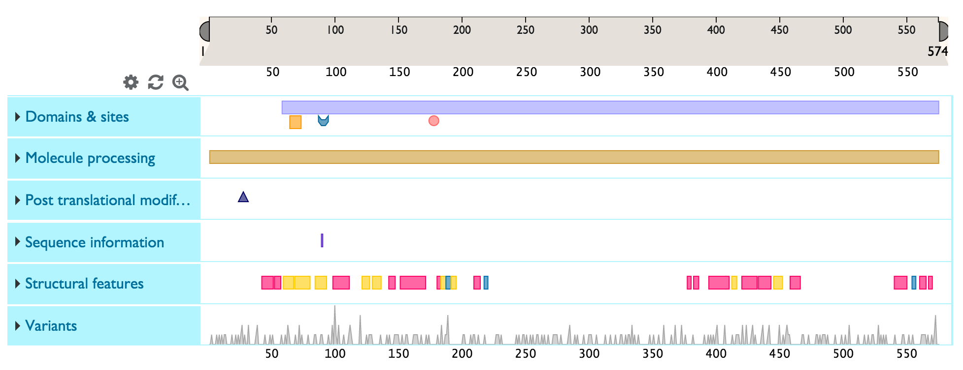
How to use BioJS component?
Protein Feature Viewer
The Feature viewer presents sequence feature tracks under a ruler that represents sequence length for the selected protein.

Slide 32
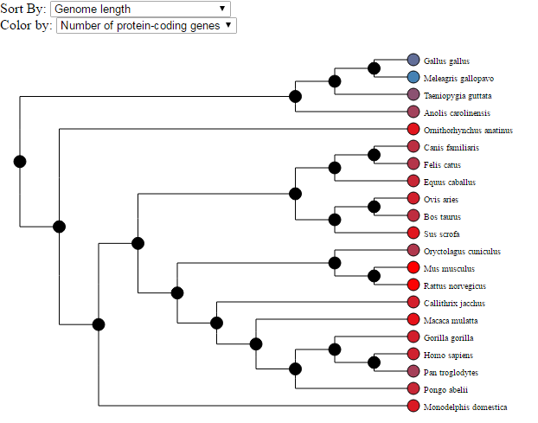
How to use BioJS component? (Exercise 3, together)
TnT Tree
TnT Tree is a javascript library for displaying trees. It is part of the the TnT set of visualisation libraries to display trees and track-based visualisations.

Slide 33
What is Node.js? (basic)
Open Source, cross platform Development platform
Uses V8 JavaScipt engine (Google)
“JavaScript on the server”
Node.js is a command line tool
Developed in 2009, published in 2011

Slide 34
What is Node.js? (advanced & confusing ;-))
Node.js uses an event-driven, non-blocking I/O model, which makes it lightweight. (from nodejs.org!)
It makes use of event-loops via JavaScript’s callback functionality to implement the non- blocking I/O
Programs for Node.js are written in JavaScript but not in the same JavaScript we are used to. There is no DOM implementation provided by Node.js, i.e. you can not do this: var element = document.getElementById(‘elementId‛);
Everything inside Node.js runs in a single-thread
“everything runs in parallel except your code”

Slide 35
Node.js – hello world.
Create file hello.js:
console.log(“Hello world”);
Run in the console:
node hello.js

Slide 36
Node Package Manager (NPM)
www.npmjs.org
350.000+ modules
package.json file (npm init)
npm install <module.name> --save

Slide 37
Exercise 4 (together)
Write a module that will write on the console current weather in Recife, Brasil (at least temperature in Celsius).
Tip: take a look at API: http://openweathermap.org/api

Slide 38
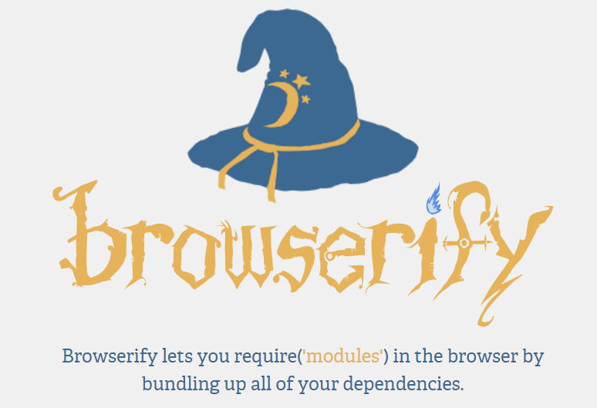
Node.js – server-side JavaScript?

Slide 39

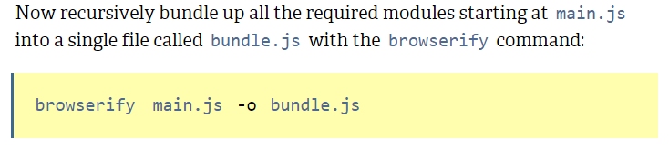
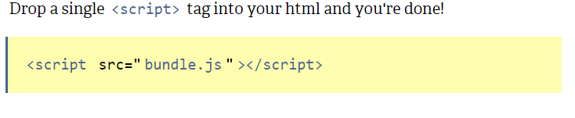
Browserify – install and use

Slide 40
Exercise 5 (together)
Modify the code from previous exercise to show the weather info in a browser.

Slide 41
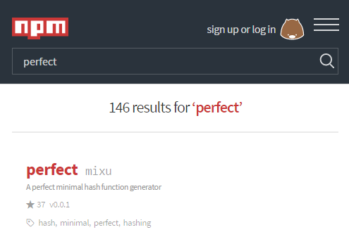

Extending existing modules
It’s perfect, but can we change color from pink to grey?
No, pink is the best and only option.

Slide 42

Extending existing modules
Download sources from repository: git clone https://github.com/source-to-the-project.git
Read documentation!!!
Install all dependencies: cd projectDir npm install
Make changes in the code
Build project. Usually it’s something like: npm run build
Test if your changes work

Slide 43
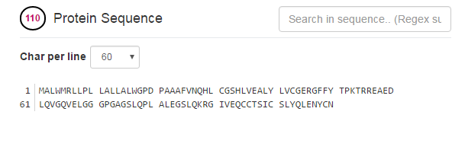
Extending existing modules (Exercise 6, together)
Sequence Viewer (https://github.com/calipho-sib/sequence-viewer)
What is missing:
“Char per line” options are hardcoded - allow user to define it (easy)
When window width is smaller than displayed protein sequence the scroll scrolls line number header – fix the position of the line numbers (medium)
Apart from line number indicating protein position it would be nice to have column number values indicating position (might be difficult)
Any other custom suggestion

Slide 44
Exercise 7 (alone)
Create a custom component that will visualize/provide some data relevant to your research
Example 1: Connect to pubmed database and print all publications for defined author name. Tip: Take a look at europepmc API http://europepmc.org/RestfulWebService#search
Example 2: Show image of a molecule structure when molecule name is given. Tip: Take a look at chembl API https://www.ebi.ac.uk/chembl/api/data/docs

Slide 45

Maintenance
Software maintenance is the modification of a software product after delivery to correct faults, to improve performance or other attributes.
A common perception of maintenance is that it merely involves fixing defects.
Software maintenance is the general process of changing a system after it has been delivered.

Slide 46
Maintenance –problems
“The fundamental problem with program maintenance is that fixing a defect has a substantial (20-50%) chance of introducing another. So the whole process is two steps forward and one step back…”

Slide 47
Types of Software Testing
Unit Testing (do the parts perform correctly alone?)
Integration Testing (do the parts perform correctly together?)
User Acceptance Testing (does the system meet the end user’s expectations?)

Slide 48
The concept of unit testing?
A unit test is code written by a developer that tests as small a piece of functionality (the unit) as possible
One function may have multiple unit tests according to the usage and outputs of the function.
Tests ensure
The code meets expectations and specifications: Does what it says it should do.
The code continues to meet expectations over time: Avoiding regression.

Slide 49
How to test Node.js code
We need test runner:
Mocha
UnitJS
Jasmine
Karma
Qunit
protractor
…
And assertion framework:
Chai
Should
…

Slide 50


Mocha + chai
Install
npm install –g mocha
npm install –g chai
Example test case
var assert = require('chai').assert
describe("My test suit", function() {
it("first test", function() {
var result = 3 * 6 + 4;
assert.equal(result, 22);
});
});

Slide 51

Mocha + chai
Running tests
Set up a test script in package.json:
"scripts": {
"test": "mocha test.js"
}
Then run tests with
npm test

Slide 52
Mocha + chai + DOM?
As mentioned in the beginning node.js doesn’t have access to browser specific implementation of DOM. So the following code will not work:
var element = document.getElementById(‘elementId‛);
For testing purpose there is node specific DOM implementation of window and document elements: jsdom module
Installation:
npm install jsdom
modification of tests:
var assert = require('chai').assert;
var jsdom = require('jsdom');
global.document = jsdom.jsdom(undefined);
global.window = document.defaultView;
describe("My test suit", function() {
it("first test", function() {
var element = document.createElement(‘div’);
assert.ok(element);
});
});

Slide 53
Mocha + chai + async calls?
var assert = require('chai').assert
describe("My test suit", function() {
it(“async test", function(done) {
someAsyncCall(function(result){
assert.ok(result);
done();
});
});

Slide 54
Exercise 8 (together)
Write unit tests (at least one), for our module showing weather.

Slide 55
How to ensure quality of unit tests?
Code coverage
It describes the degree to which the source code of a program has been tested. Types:
Statement Statement coverage is a code coverage metric that tells you whether the flow of control reached every executable statement of source code at least once
Function Has each function in the program been called? This metric reports whether you invoked each function or procedure.
Path This metric reports whether each of the possible paths in each function have been followed. A path is a unique sequence of branches from the function entry to the exit.
Condition Condition coverage reports the true or false outcome of each condition.
Branch A branch is the outcome of a decision, so branch coverage simply measures which decision outcomes have been tested.

Slide 56
How to ensure quality of unit tests?
Mutation tests Mutation testing evaluates the quality of existing software tests. The idea is to modify (mutate) code covered by tests in a small way and check whether the existing test set will detect and reject the change [MUTTES]. If it doesn’t, it means the tests do not match the code’s complexity and leave one or more of its aspects untested.
Tests should be good written and readable
Use tools like JSHint for static analysis of your code

Slide 57
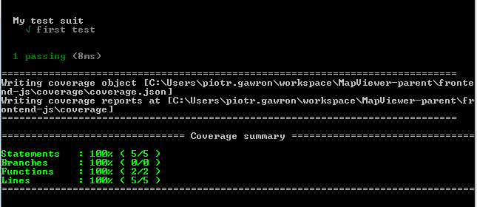
Test coverage in Node.js
Instanbul
npm install -g istanbul
Integrating instanbul with mocha:
Modify your package.json file so the test will be called via Istanbul:
"scripts": {
"test-coverage": "istanbul cover node_modules/mocha/bin/_mocha –- test.js"
}
running:
npm run test-coverage

Slide 58
Exercise 9 (together)
Improve unit tests so the code coverage will be 100% for all coverage types:
Statement
Function
Condition
Branch

Slide 59
Exercise 10 (alone)
Write set of unit test that will cover your module developed in exercise 7. If necessary refactor the original code, so you will be able to create tests that cover the code in 100%.

Slide 60
Tests summary
Write tests!
Tests Reduce Bugs
Tests are good documentation
Tests allow safe refactoring
Tests reduce the cost of change
Testing forces you to think
Tests reduce fear!

Slide 61
JSHint – what is it about
Do you know the output of the following code:
console.log('' == '0');
console.log(0 == '');
console.log(0 == '0');
console.log(false == 'false');
console.log(false == '0');
console.log(false == undefined);
console.log(false == null);
console.log(null == undefined);
console.log(' \t\r\n ' == 0);
var x = 7;
var y = 8;
if (x && y) {
console.log("comp 1: true");
} else {
console.log("comp 1: false");
}
if (x & y) {
console.log("comp 2: true");
} else {
console.log("comp 2: false");
}

Slide 62

JSHint – what is it about
“JSHint is a program that flags suspicious usage in programs written in JavaScript.”
Install
npm install -g jshint
Run
Modify your package.json file so the test will be called via Istanbul:
"scripts": {
"lint": "jshint src/. test/."
}
running:
npm run lint

Slide 63
Exercise 11 (alone)
Run JSHint on your code module and try to remove all errors that might appear.

Slide 64
JavaScript - it’s all in the browser
When we add more and more libraries to our code the output file size might be huge.
It will slow down loading of our app (bigger files to download by the browser)
It might slow down running of our app.

Slide 65
JavaScript - it’s all in the browser
“Don’t use sledgehammer to crack a nut” – when including complex library think twice if it’s needed
Use compressors for your JS and CSS:
node-minify
uglify-js
If nothing else helps try to dynamically load javascript when needed

Slide 66
Node.js modules – summary remarks
Consider size of the output js file when including additional libraries
Write tests
Spend some time to make your code understandable for people who might come across and are not familiar with it

Slide 67

Cytoscape
It is an open source bioinformatics software platform for visualizing molecular interaction networks and integrating with gene expression profiles and other state data.
Cytoscape also has a JavaScript-centric sister project named Cytoscape.js that can be used to analyse and visualise graphs in JavaScript environments, like a browser.
De-facto standard software in biological network research community

Slide 68
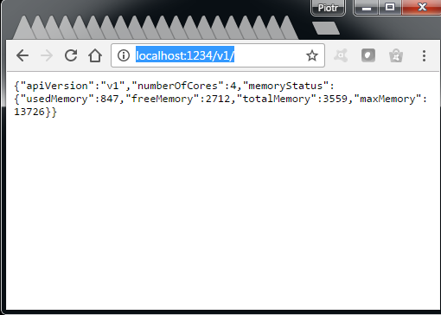
Programmatic access
Requirements
Cytoscape 3.2.1 or newer
Latest version of cyREST app (in Cytoscape 3.3 and higher it’s a built-in plugin)
Postman – REST client (application in Chrome)
Test cyRest
After starting Cytoscape open in a browser address: http://localhost:1234/v1/

Slide 69
Programmatic access
Requirements
Cytoscape 3.2.1 or newer
Latest version of cyREST app (in Cytoscape 3.3 and higher it’s a built-in plugin)
Test cyRest
After starting Cytoscape open in a browser address: http://localhost:1234/v1/

Slide 70

cyRest
cyREST provides programmer-friendly simple RESTful API. This means you can use virtually all kinds of programming languages to access Cytoscape basic functions, such as loading networks, visualizing them with custom Visual Styles, and generating PDF/SVG/PNG files from your network views.

Slide 71

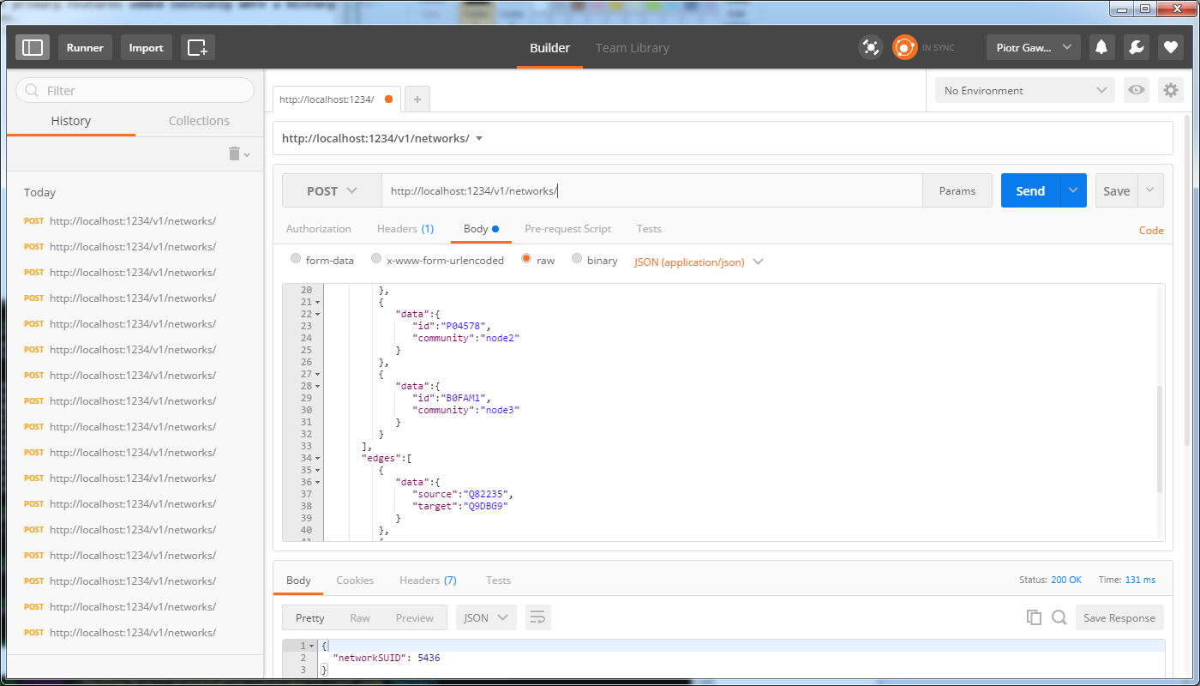
Postman
Postman is an application that helps building/testing REST APIs.

Slide 72
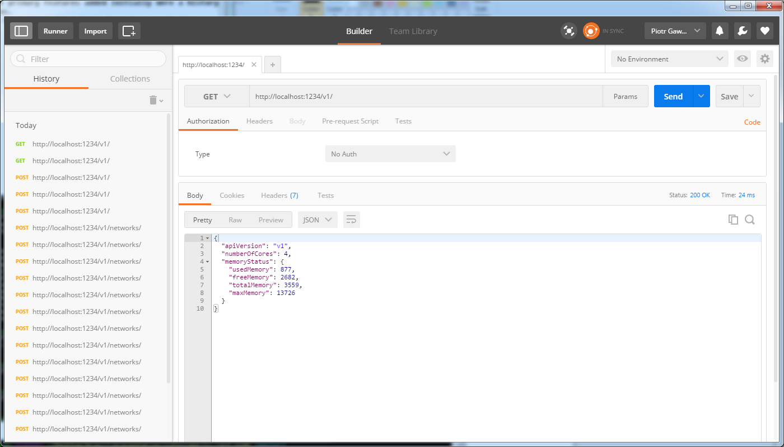
cyRest – check connection via Postman

Slide 73
cyRest – check connection via Javascript
var request = require('request');
var baseUrl = "http://localhost:1234/v1/";
request.get(baseUrl, function(error, response, body) {
if (!error && response.statusCode == 200) {
var content = JSON.parse(body);
console.log("API version: "+content.apiVersion);
} else {
console.log('error: ' + response.statusCode);
}
});

Slide 74
cyRest – check connection via R
library(RJSONIO)
library(httr)
port.number = 1234
base.url = paste("http://localhost:", toString(port.number), "/v1", sep="")
version.url = paste(base.url, "version", sep="/")
cytoscape.version = GET(version.url)
cy.version = fromJSON(rawToChar(cytoscape.version$content))
print(cy.version)

Slide 75
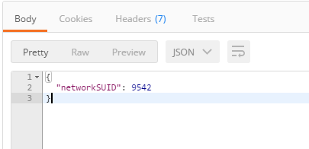
cyRest – create network
Network (in JSON) must be sent to the following address http://localhost:1234/v1/networks using POST method:
{
"data":{
"name":"test"
},
"elements":{
"nodes":[
{ "data":{ "id":"Q82235"} },
{ "data":{ "id":"Q9DBG9"} },
{ "data":{ "id":"P04578"} },
{ "data":{ "id":"B0FAM1"} }
],
"edges":[
{ "data":{ "source":"Q82235", "target":"Q9DBG9" } },
{ "data":{ "source":"P04578", "target":"B0FAM1" } }
]
}
}

Slide 76
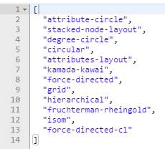

cyRest – change the layout
Lets find out what layouts we have: GET http://localhost:1234/v1/apply/layouts
And apply selected layout to the created network:
GET http://localhost:1234/v1/apply/layouts/force-directed/9542

Slide 77
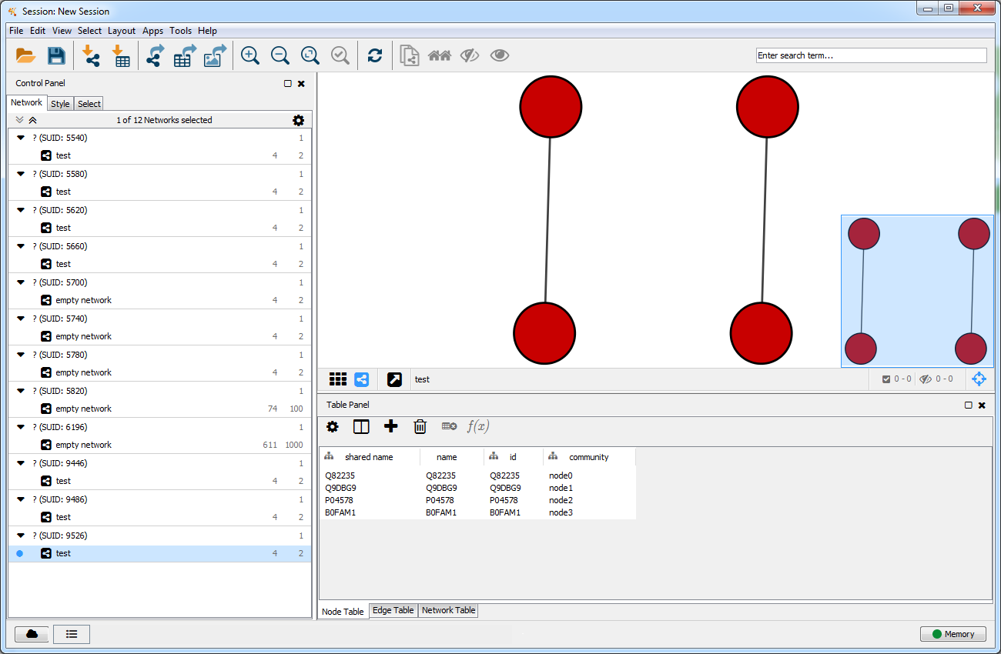
cyRest – change the layout

Slide 78
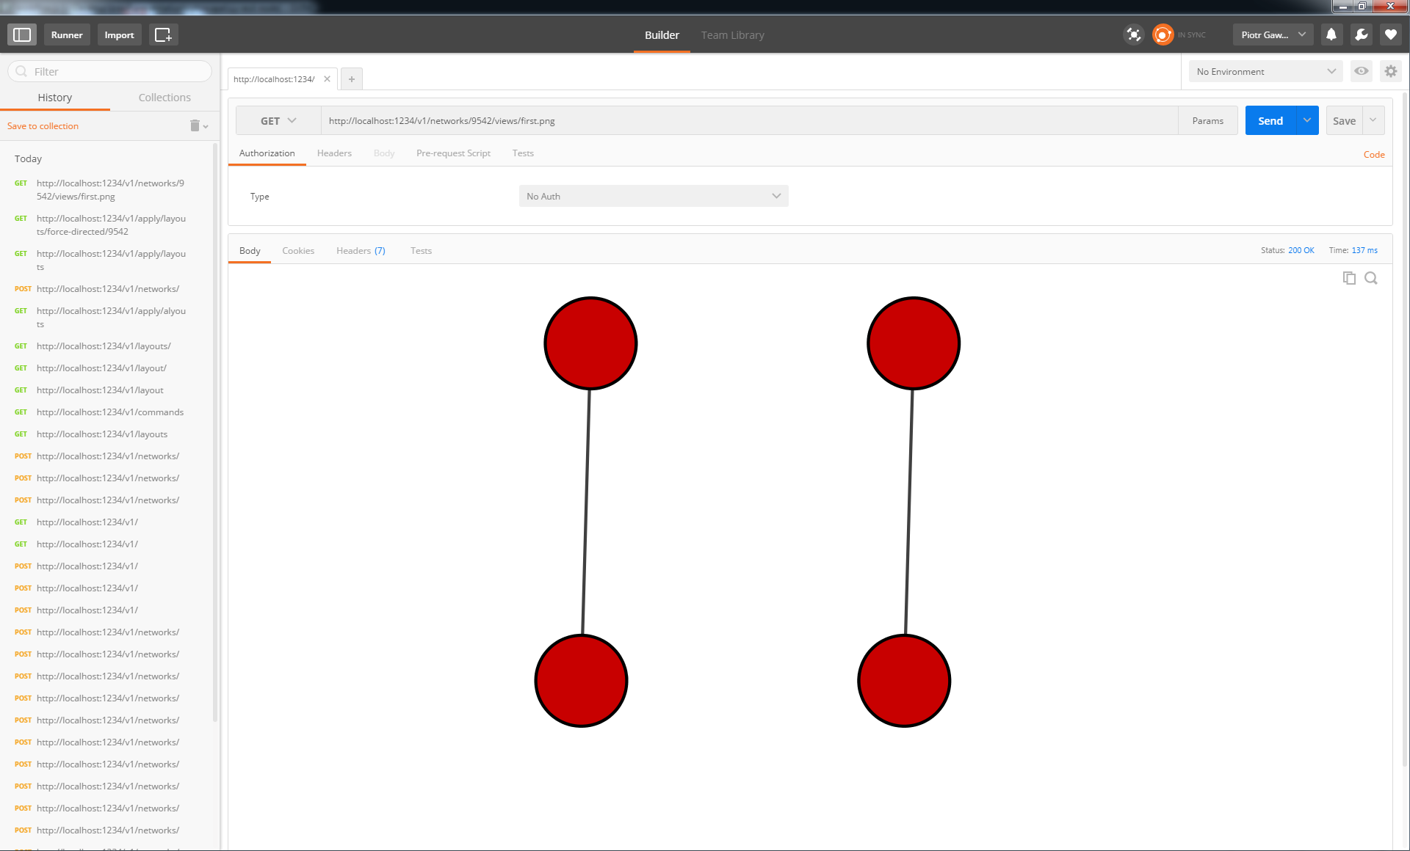
cyRest – export as png
GET http://localhost:1234/v1/networks/9542/views/first.png

Slide 79
cyRest – remove the network
Single network by ID
DELETE http://localhost:1234/v1/networks/9542
All networks
DELETE http://localhost:1234/v1/networks

Slide 80
Exercise 12 (alone)
Write code (in JavaScript or R) that will connect to Cytoscape. Send there a random network consisted from at least 10 elements and 20 edges. The network should be arranged with one of predefined layout algorithms and the snapshot picture should be taken of obtained network.
References
https://github.com/cytoscape/cyREST/wiki/Quick-Start-Guide (Quick start guide about cyREST)

Slide 81
References
http://www.slideshare.net/ErikvanAppeldoorn/introduction-nodejs-32863981 (node.js tutorial)
http://www.slideshare.net/vikasing/introduction-to-nodejs-11730771 (node.js tutorial)
http://biojs-edu.github.io/Vizbi-2016/dist/index.html#/1 (biojs tutorial)

